Slide 1
Software Dev for IoT Systems csCI 7000-008 Tue/Thu @2Pm,
Danny Dig
Notes:
TODO: take the Costa Rica T-shirt with me. Ask for permission to record on Zoom. START Recording on Zoom.
Welcome to the grad class on SW DEV for IoT where we discuss the design of intelligent IoT software systems. I am so excited to be teaching this class, I have been looking forward to this moment for months and I even visited our on-campus location in DCL to get familiar with the space. I can’t wait for us to be able to meet again in person on campus and welcome you in person in DCL.
I am a new faculty at CU this is my second year, I have arrived from Oregon, just in the nick of time before everything shut down because of covid. So even though I have been in Boulder for 2 years now, I am grateful because I still feel like a newbie and learning and discovering new places, new people, new activities.
I want to spill the beans right from the beginning so that you know what you are in:
The good news is that I am all pumped up with excitement for everything CU-related. The bad news is that a lot of things are still in flux, and I am learning a lot of how CU operates, especially as this is the first time I am teaching a grad-only class at CU. This means that I am building my wings on the way down. We tried to have this class last semester and some of you even enrolled in it, but then we had to drop it because of not enough people. Now it’s a different story.
But I am committed to provide for you the best experience possible in a graduate classroom. One of my core values in life is to exceed your expectations, and if you allow me, I will try my best to exceed your expectations in this class.
I am looking to you as thinking partners, this field is so broad, that no one can be an expert on everything. I am learning alongside you, but I guarantee that we will have a great journey together.
Just a couple of hours ago I was on a panel discussion with my friend Jason Shepherd, the former CTO for IoT at Dell Technologies who is now the VP for Zededa, and group of illustrious speakers from Siemens, Verizon, and Dell. The panel on 5G and whether is it Hype. There is hardly any TV show that does not show a 5G comercial. The hype is consumer 5G sale hype. Until the apps catch up and it is ubiquitous you are not going to see the realization of the big promises of IoT. So indeed these are very interesting times that we live in, as the convergence of 5G, IoT, Edge Computing as enabler, AI and sensors enable the Digital Transformation. This was a trend that was actually happening and was significantly accelerated by Covid.
=====
ASK: How many people have at least one smart IoT device? Please raise your hand.
If you have a smartphone, or a smart watch, welcome to the IoT family.
It seems that everyone raised the hand, so I am in the right room with the right audience. This talk is about you.
====
ASK: Have you received my welcome email that I sent you yesterday?

Slide 2
Today’s goals
Discovery: learning about each other (Family Occupation Recreation Motivation)
What is Pervasive Personalized Intelligence?
Examples of Research themes on IoT
How can I be successful in CSCI 7000-005/6?
Notes:
Today’s goals
ASK: Have you received the welcome email that I sent yesterday?
The purpose of today’s class a discovery journey. I get to learn about you, you get to learn about me and where I come from and and by the end you will find out how you can be successful in this class.
You will see how this class is different than most of courses you took in the CS department.
You will be able to decide for yourself: is this class for me?
And equally important, you will find answers to the question: How can I be successful in this class. I want you to be successful in this class and I want every single one of you to get an A.

Slide 3
Family

Slide 4
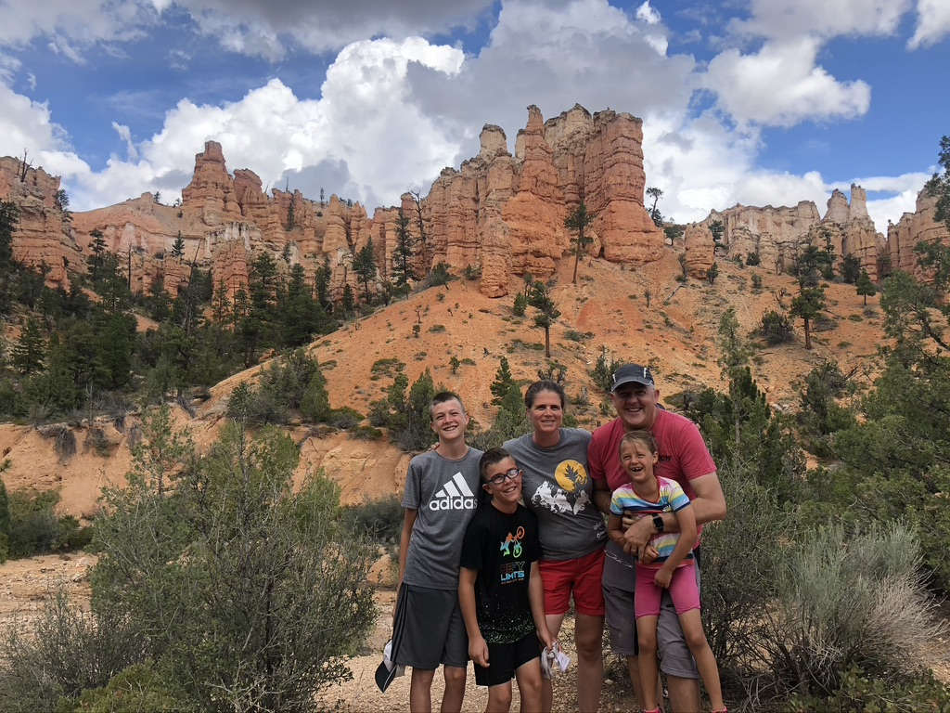
Family
Notes:
ASK: anybody knows where is this picture taken?

Slide 5




Occupation: Faculty in Software Engineering
Change is the heart of software development
Programming is program transformation
Q1: Analyze what software changes occur in practice?
Q2: How can we automate them?
Q3: Can we represent programs as transformations? Archive, retrieve, and visualize them?
Q4: Can we infer higher-level transformations?
Automated changes in (i) upgrading library APIs, (ii) convert sequential to parallel code, (iii) improve responsiveness in mobile
Notes:
My research area is software engineering, and I specialize in software evolution.
In today’s world, software evolution is at the heart of any successful software. Successful software undergoes constant change. Typical changes are to add more features, fix bugs, improve performance, security, etc.
If we want to foster a revolution in software technology, similar with the industrial revolution, Change needs to move to a higher level of abstraction.
click
I envision a programming environment that places transformations at the center of software development, as first-class citizens.
My research addresses several important questions:
- what are the changes that occur most often in practice?
- and how can we automate them to improve the programmer's productivity and software quality?
Over the years my research team has been successfully automating three kinds of changes: upgrading library-based application to use the latest version of the library APIs on which they are based; updating obsolete tests to bring them in sync with the current version of the software; converting sequential code to parallelism so that the software runs efficiently on todays multicore machines. And upgrading mobile apps to improve responsiveness.
ASK: I am a contributor to the Eclipse, NetBeans, VisualStudio, and AndroidStudio development environments. Anybody here is using any of these IDEs?
---------
click
To turn this vision into reality, my research is driven by important questions:
- what changes occur most often in practice?
- how can we automate them to improve the programmer's productivity and software quality?
- Can we represent programs as sequence of transformations? How are we going to archive, retrieve, visualize such transformations?
- Can we infer higher-level transformations from lower-level changes, especially code edits?
Answering these questions is relevant and important for practice, as well as intellectually challenging and interesting
click
Our friend Mike, performs manually a few of his changes, then he creates a custom automated transformation, or better our environment infers his transformation and creates a custom automated transformation. Mike can reuse this transformation on the Brazilian code base, even though this code bases uses completely different names for the code elements.
click
-even manual edits become program transformations and are grouped and represented at a higher-level of abstraction
click
-Because our novel environment promotes an orthogonal view of programs as a sequence of higher-level transformations, Carol can easily make sense of the new code base when she comes from vacation.

Slide 6
Work in Your Strength Zone but Reinvent Yourself
Mobile [’13 - ’18]
-add async
-fix async
-privacy
Parallelism & Concurrency
[’08-’13]
Refactoring
- make thread-safe
- improve throughput
- improve scalability
Library migration [’02-’07]
- upgrade APIs
programs
IoT and ML [’19– TBD]
-from deterministic to probabilistic
Principles for changing between different programming models
Notes:
Many times, people might tell you that you need to be good at everything: The truth is that you cannot be an expert on everything, you need to know a little about everything (so that you can see connections) but focus on the area that you are passionate about and you are good at (I call this the strength zone). Spend most of your time and energy in that area, do not attempt to be good at everything, because then you will be average and mediocre at everything.
This is my personal story of working on refactoring. I’ve been working on refactoring for 20 years.
When I meet people at the conferences, they ask me about my current work, and I tell them that I still work on refactoring. They ask me: Danny, Don’t you get bored working on the same refactoring topic?
<CLICK> During my 5 years of PhD I worked on Upgrading library-based applications to use the latest API of their libraries, even when these APIs were refactored. In this stage I learned about static program analysis and learned the Eclipse refactoring engine so well that I became a contributor to Eclipse.
<CLICK> Just as I was finishing my PhD in 2007, the world of computing was completely shaken up when Intel stopped producing single processor systems, and went into multicore.
So my interest shifted towards refactoring existing sequential programs to make them run in parallel, make programs thread-safe, and refactorings to improve the scalability of already parallel programs
This new world forced me into much deeper program analysis than I have done before.
<CLICK> But just about when I started to get comfortable with parallelism, the world changed again. People stopped buying laptops and everyone was on mobile devices. So I took what I learned from the parallelism domain, and adapted it to the new challenges of working with event—driven apps.
<CLICK>: now I am making the transition to yet another big domain: the digitalization of our world with IoT and how the sensors around us will collect information about us and the world that will augment our intelligence. In this new paradigm, how do we refactor existing programs that use deterministic algorithms into programs that use probabilistic computation and ML and continuously learn?
Key lesson that I learned: many times I ventured beyond refactoring into other areas (like HCI or Compilers) that were not my strenghts. I kept failing over and over until I learned to partner with others who were strong in the areas I was weak.
CLICK
I decided to stay and work in my strength zone: principles for refactoring programs between significantly different programming models, both in terms of the control-flow (from synchronous to callback-based, from sequential to parallel) and program state (from stateful to stateless execution, and from shared- to distributed- memory style of communication)
But at the same time I keep an eye open on big changes in the field of computing, and I am reinventing myself every 5 years. This way I remain fresh and keep learning while I stay in my strength zone
==
Gesture: stand in the middle and point at the screen at the different areas.

Slide 7





What is Your Dream? Mine is Practical Impact on SW Development
Automating
Inferring
- used at
- dozen labs
-ship with official
Refactoring
- hundreds of
accepted patches
founded Workshop
on Refactoring Tools,
HotSwUp, Dagstuhl S.
- first open-source
refactoring
Understanding
- shaped APIs in Java and .NET official concurency libraries
-learnparallelism.net 150,000+ visitors
Testing
Notes:
Here is another teachable moment for you as students.
Identify your Dream.
What do you want. What do you really, really want?
Do you want to publish papers? Do you want to have lots of citations?
My dream for me is making a practical difference in the life of real software developers.
CLICK
For example, several of our refactoring tools ship with the official release of IDEs such as Microsoft Visual Studio, NetBeans, Eclipse, AndroidStudio which are used daily by millions of software developers
CLICK
Using our tools, we generated hundreds of change patches that were accepted in famous open source projects such as Apache foundation such as Cassandra which is used for big data processing in every single Fortune-500 company.
CLICK
Several years ago I developed the world’s first open-source refactoring engine for Java
CLICK
The work on inferring API-level refactorings is used at Google, IBM, and dozens of labs
CLICK
Some of our testing work has been integrated in the testing infrastructure of the NETBEANS IDE at Oracle
CLICK
moreover, the formative studies that we conducted to reveal misuse, underuse, and abuse of parallel constructs has already shaped APIs in Java and .NET official concurrency libraries
Some of the educational resources that we developed, have already received hundreds of thousands of visitors
CLICK
I am not telling you all this to impress you, but to impress upon you that it takes a mindset and dedication to identify what’s your dream and to pursue it. None of these adoption in industry have happened by chance, by publishing papers and then hoping that one day somebody in industry finds them. I was proactively pursuing industrial collaborations.
You might think that sometimes publishing papers is going in the opposite direction to your dream. I am learning how to make academic papers serve my dream by going the extra mile to move research into practice.

Slide 8
Recreation

Slide 9
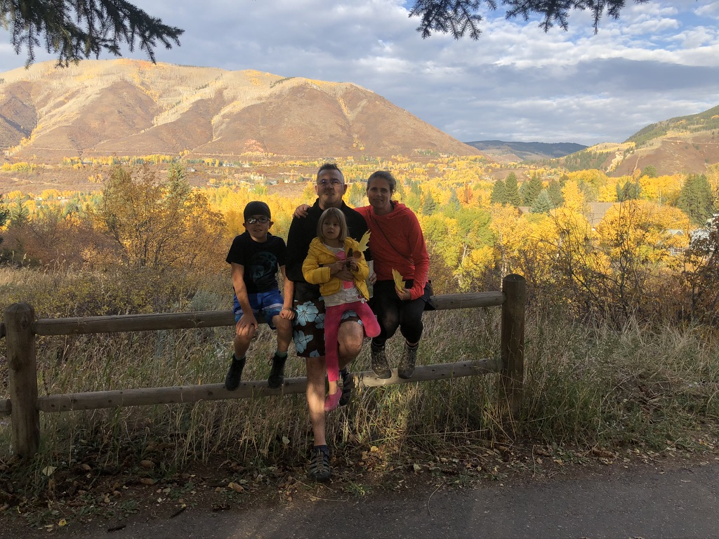
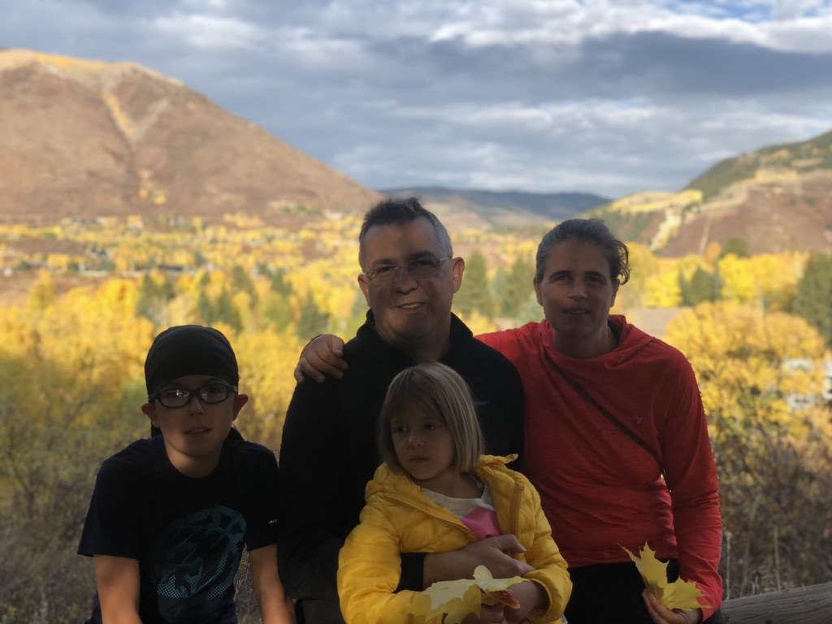
Recreation
Notes:
ASK: anybody knows where is this place?
Aspen CO.

Slide 10

Recreation
Notes:
ASK: anybody knows where is this place?
This was a year ago in the week between Christmas and NY, at Copper Mountain. This year since we did not get enough snow in Colorado, we went skiing with my whole family to Utah.

Slide 11
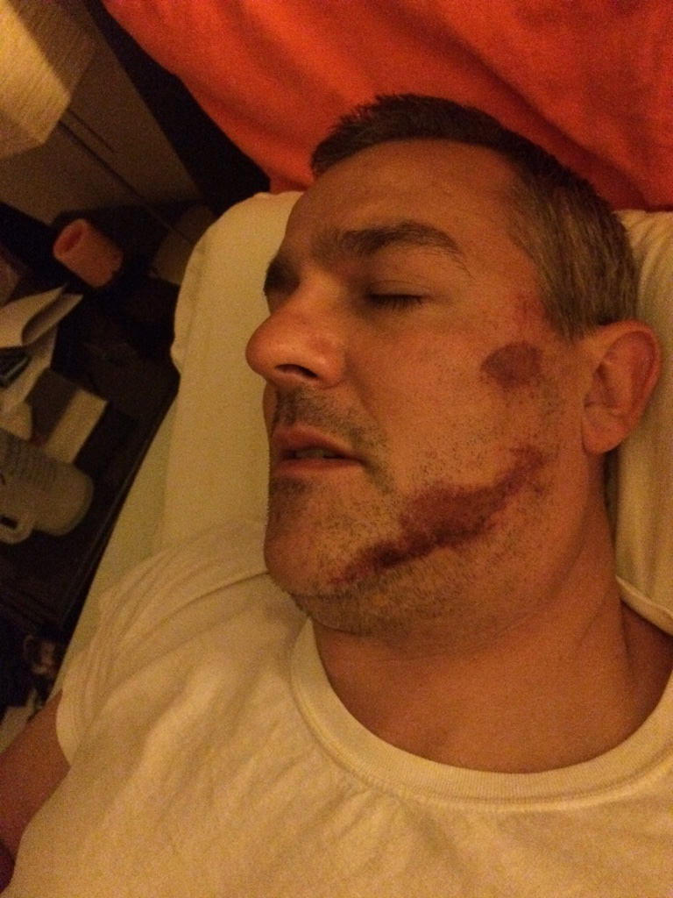
On Aug 5, 2015 …
From personal success to significance
From a ladder climber to a ladder holder
Notes:
One day, I opened my eyes and found myself in a strange place, stranded on a white bed, in a white room.
On the wall in front of me was a whiteboard on which was written: Today’s date is Aug 5th, 2015, this is the Good Samaritan Hospital in Corvallis Oregon.
I asked a person in white why I am there, and she told me that I had a <CLICK>bicycle crash.
I did not remember any accident, I no longer remembered what year it was, or how many children I had or what was their birthday. I was happy to recognize my wife. Note to self: when something back happens, make sure that you remember the people closest to you.
When she came to my bed I kept asking her: <CLICK BACK> honey where I am and why I am here.
She told me the same story: I crashed my bicycle <CLICK FORWARD>. A minute later I would ask again <CLICK BACK> "honey where I am and why I am here", and my patient wife kept telling me the same answer <CLICK FORWARD> .
<CLICK FORWARD> You see, I had suffered a severe brain concussion in which I lost my short term memory, so my memory was resetting every 2 minutes.
<CLICK> The days and months after my accident I reflected on my life. While my brain was foggy from loss of short term memory, I had the best clarity of mind and I was seeing the big picture. I saw how selfish I was, and while being very successful in academia, I was using people to serve me.
For example, I was focusing on the research that the students was producing and less on the students. I was the proverbial farmer who cared more about the golden egg than about the golden hen.
I decided to turn my life around, and decided it was time for me to serve people, instead of waiting to be served.
Everyday I am learning how to intentionally serve people and add value to others.
Everyday I am learning how to shift from being a ladder climber to being a ladder holder. I want you to reach higher than I did, to go further than I did.
I shifted from being preocupied by my own success to mentoring more junior faculty so that they can learn and avoid the mistakes I made.
I will give you unprecedented access to behind-the-curtain information on how I do research;
Some of these are brand new insights that I have never shared before. So when you see the Owl icon, I am about to share one of those insights.
I am So excited to share these with you.
===
Notice: don’t talk

Slide 12

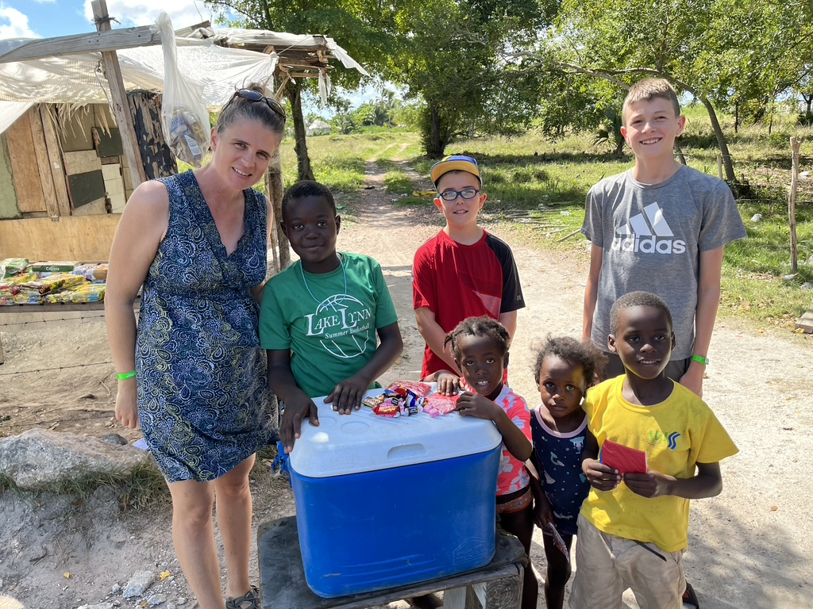
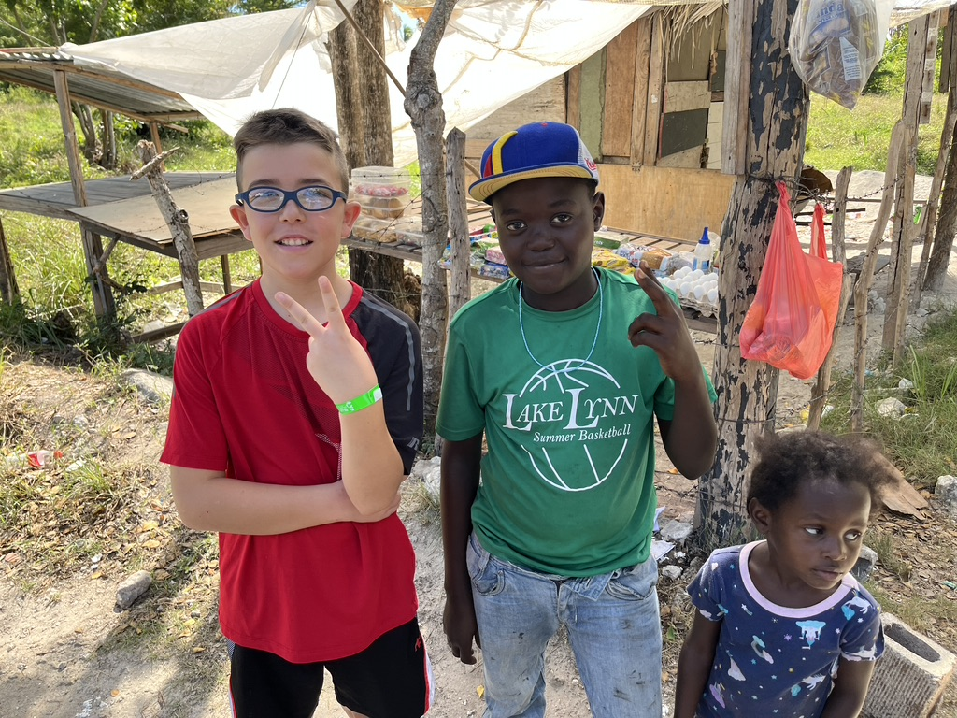
Motivation
Notes:
Last November I went on an extended trip to the Dominican Republic with my mentor John Maxwell (the #1 leadership expert in the world) and 200 of our leadership coaches. The DR president invited us to start a leadership transformation for the whole nation. I am so grateful that we trained 37,000 leaders from all major streams of influence (government, business, education, non-profits, sports, media, health, etc.). I came home also transformed and with a renewed sense of gratitude for everything we have at home.
CLICK I want to share with you a personal story that changed my perspective. As my family joined me for this extended trip in the DR, one day we stopped by on the side of the road to help some local kids that were making a living by selling cold water and basic staple foods. We came prepared from home with candies and small toys to share, and my 3 children got to experience the joy of helping some less fortunate kids from the DR. We were about to leave, when the older DR boy pointed to my son's hat. Even though we could not communicate with him, we knew that he really liked that hat. Before I tell you what happened next, you need to understand the story behind this hat. My son Alek and I love downhill mountain biking. We spent a memorable weekend in 2020 at our favorite downhill bike park, Trestle Bike Park in Winter Park Colorado. At the end of the weekend I asked my son what I can buy him so that he would always remember our special weekend. My son asked me for a hat with the Trestle Bike Park logo. He has been wearing this hat every single day of his life ever since summer 2020. He's been wearing it outside of the house. He has been wearing it inside of the house. Summer and Winter, Spring, and Fall. Day and night. He only takes it off when he goes to sleep. When the DR kid asked Alek for his hat, my son took it off.
<CLICK> My family asked him if he really wanted to give it to the DR kid, and my son said absolutely yes. My heart filled with joy and my eyes filled with tears when I saw Alek's act of kindness. Giving away the candies and the toys was no sacrifice for Alek, because I was the one who bought them. But giving away his most valuable possession was a true sacrifice. You can see the happy smile on his face, and how much his gift meant to the DR kid. I was so grateful that Alek understood at age 10 that in life we are more happy when we give than when we receive.

Slide 13
Quiz #1: About YOU
Write down your name
FORM (family, occupation, recreation, motivation)
Grad Program (e.g., CS PhD, MS, etc.), year of study, who is your grad advisor
Your background (e.g., industry experience, other CS background – such as strong ML, Systems, IoT, SE, etc.)
What is the ONE Thing that you expect to take out of CSCI 7000-008?
- What are your plans post graduation?
Notes:
Open a Google Doc, and then Take 5 minutes to fill in some information about you that you want to share with me and your classmates.
Quickly introduce your name, grad program, background, expectations.
If there are few students in the class, ask them to share with others what they wrote, otherwise collect the paper and sample a few one
s.
- do some cool IoT project to help society.
- expect: learn more about IoT examples, applications around the world

Slide 14
What are your expectations from CSCI 7000-008?
Do a cool IoT Project that helps society
Learn about exciting IoT Applications
Learn about Security for IoT Devices /Blockchain
E. Want exposure to the research of IOT in AI and Do some automation project.
G. Learn about the Challenges in IoT industry
H. Learn how IoT software differs from classical software
Notes:
..How to communicate technical material to outsiders
.. How do we conduct industry-relevant research
.. Understand limitations and opportunities of IoT
… Learn applications of IoT for human users
… Whole picture vantage of IoT, how to process IoT data
Overview of IoT applications in healthcare, and the rest of the field
Common challenges across different applications and how we approach them with reuse
…Get ideas for PhD/MS dissertation
…Learn about the Practical aspects of SE
…Learn about the Theoretical aspects of SE
….Learn about the state of the art in SE
Get equipped for being a researcher
Improve programming skills

Slide 15
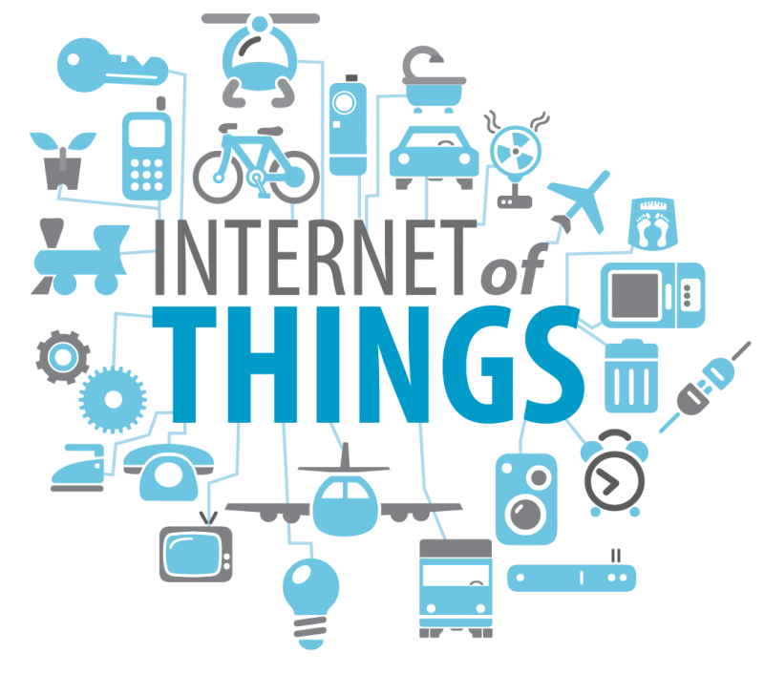
Theme: IoT
IoT revolution: digitization &
connection of everything
In 15 years, smart
Infrastructure estimated to
become $59T market
Q: What do you envision as some Killer Feature for IoT?
Notes:
With IoT, we are at the dawn of a technological revolution that rivals the industrial revolution. This new era is marked by the digitization and connection of everything. Huge productivity gains will come from augmenting our intelligence with knowledge that expedites decision-making, everyday activities, and processes.
<CLICK>
ASK: If you can envision a killer feature that IoT devices and serice can do for you in the future, what would this be? For a minute, let your imagination run loose and dream about the future.
Go to next slide and type down their answers.
TODO: repeat their message back: so what I hear you saying is that you wished you had a personal assistant who would help you do X…

Slide 16
Q: What are the Killer Features for IoT?
K1: Save our resources (green, sustainable world)
K2: Track health and alert authorities when in danger
K3: Everything is easy to control without hassle (e.g., home automation)
K4: Making resource consumption more efficient (Nest thermostat)
K5: Using IoT to detect cancer and serious diseases faster
K6: Using IoT to detect cancer and serious diseases faster
K7: Reduce risk of working in dangerous areas (nuclear)
Notes:
Ask them to tell me what they wished the IoT did for them in the future
TODO: repeat their message back: so what I hear you saying is that you wished you had a personal assistant who would help you do X…
====
K1: Precision Ag: automate food production, and eliminate waste
K2: Transportation across the board
K3: Big data: data-driven decision making
K4: Climate control improvement
K5: Predict & improve human health
K6: Smart city
K7: Distributed, custom production and manufacturing
=====
K1: smart decisions without exposing privacy and security
K2: standards for devices to communicate
K3: digital identity
K4: personalization of sw services
K5: raising the level of abstraction for programming IoT devices
K6: new ways for humans to control devices
K7: virtual assistant to automate repeated tasks
=====
Last year people gave these answers:
K1: privacy & security for multi-user scenarios
K2: Better energy-aware apps
K3: More proactive assistance from the mobile device
K4: self-cleaning, maintenance of the resources
K5: assistant to change human habits
K6: Better bug reporting for end users
K7: Porting of apps between platforms

Slide 17
Q: What are the Killer Features for IoT?
Smart home:
- managing the home (monitoring energy and resources), scheduling family activities, housekeeping (auto-replenish consumables, cleaning, pet feeding), health monitoring (assistive care)
Smart City:
- transportation (find parking), environmental monitoring of pollution, manage resources (control street lighting), enhances perception of city activities (e.g., sporting events)
Smart Manufacturing:
- virtual chief foreman assisting managers
Notes:
In a Smart Home deployment, IoT saves time by taking over the mundane and operational aspects of our lives such as managing the home (e.g., monitoring energy and water consumption), scheduling the activities of a family, and managing housekeeping (e.g., automated replenishment of consumables, cleaning, pet feeding, and yard management). It also manages our health; for example, by analyzing personalized biometric data from smart wearable sensors and determining when quality of life has degraded for the elderly and identifying that they need, for example, assistive care, medication sensors, or child/infant monitoring.
In Smart City deployments, IoT saves time for individuals (e.g., finding available parking - maybe you've already used this in airports parking garages), informs city planners about the environment (e.g., environmental monitoring of pollution), manages resources by local government operations (e.g., control of street lighting), and enhances our perception of the activities in the city (e.g., face recognition of key action players during a sporting event), etc.
In Smart Manufacturing deployments, IoT removes knowledge barriers to enable optimized decision making (e.g., a virtual chief foreman assisting managers), and based on analytics, it automates business processes and workplace tasks.

Slide 18
From IoT 1.0 to 2.0
V 1.0: sensors and actuators to collect data
V 2.0: augmenting our intelligence with knowledge to expedite decision-making, everyday activities, and processes
Notes:
Whereas previous substantial gains in productivity came from augmenting human muscles with machinery, the next wave of productivity will come from augmenting our intelligence with knowledge to expedite and optimize decision-making, everyday activities, and processes.

Slide 19
Center on Pervasive Personalized Intelligence
http://ppicenter.org
Notes:
Today I want to let you in one of our best-kept secrets at CU, And I hope that by the end of my presentation this becomes one of our best well known secrets.
I invite you to learn about our NSF Center on Pervasive Personalized Intelligence that we started at CU with partners at OSU and our founding industry members; NEC, Itron, and Trimble.
I will present the vision of the research Center, the Value that we are providing to you as students who will have access to our industry partners.

Slide 20
Listening to Industry during Discovery Visits
YouBase
Lo3Energy
Notes:
For the last 5 years I have visited executives in industry, and I am very gracious they welcomed me and several of our CU colleagues who joined me on some of these trips..These are the 70+ companies we visited these last 5 years.
During these discovery visits with C-level executives and directors, we asked them questions about what are they proud of accomplishing, what excites them as the next growth in computing, what are the challenges they have and areas in which they need help from universities, what are some upcoming opportunities for collaboration..
=====
And we want to keep listening today and tomorrow too. In a few minutes we will ask you about your goals and expectations for these 2 days Because we want to see things from your perspective.

Slide 21
Pervasive Personalized Intelligence (PPI)
Connecting everything for remote monitoring
and service
From Reactive to Predictive Analytics:
Smart Energy: safe energy mode for e-cars
Precision Ag: predict diseases, harvest
Industry 4.0: preventive maintenance
Pervasive to the Edge
Personalized
Notes:
The theme of these many stories I collected from the 100+ companies is around IoT software systems make sense of the world around us and augment our intelligence.
The pandemic has significantly accelerated trends such as connecting everything to the internet for remote monitoring and remote service and better analytics. For example, the repair person can service your smart home appliances without ever coming to your home. We talked with a thought leader at NextEraEnergy and they installed many sensors on the wind turbines so that they know precisely when there is a failure and which of their 50,000 wind turbines needs what kind of service.
But I hear that industry is excited about Pushing computing and intelligence beyond being reactive and making sense of the past events into being anticipatory and predictive about the future.
Smart Energy: consider an electric vehicle. The Drivable distance to the destination is more than what the available battery power can support in Normal vehicle mode. To conserve battery, the vehicle predicts which non-critical applications the user would not need and switches those to low-power mode.
Take for example Trimble, one of our industry founding members, and a global leader in Precision Agriculture. Trimble gathers and analyzes data from every action performed and helps guide future decisions: what seed to plant in what field, or where exactly you need a precise amount of fertilizer or chemical. They want to predict when the disease is happening, and locally apply preventive treatment, which will minimize the amount of chemicals that get into our watersheds.
Smart Industrial Automation : preventive maintenance and auto-diagnosis on the device itself: predict when a certain piece from a complex equipment will wear out and needs to be replaced. Last year when everyone could still fly, I met with Ed Bastian, the CEO of Delta Airlines and he told me how this has saved Delta 1B dollars. How many of you have ever been on a flight that was canceled due to an unscheduled maintenance operations? Ed told me that they canceled the cancelations: they reduce the number of canceled flights due to unscheduled maintenance operations from 570 a year to just around 50, and this saved Delta Airlines $1B per year.
CLICK in industry the next big growth comes from pushing intelligence from the cloud to the
edge of the network, sometimes referred as edge computing, where latency is critical, and mobility, privacy,
and context awareness are essential qualities for successful applications.
CLICK And the holy-grail of this new generation of smart software systems is personalization:
This is truly key to deliver value to the users and differentiate from competitors in the marketplace.

Slide 22


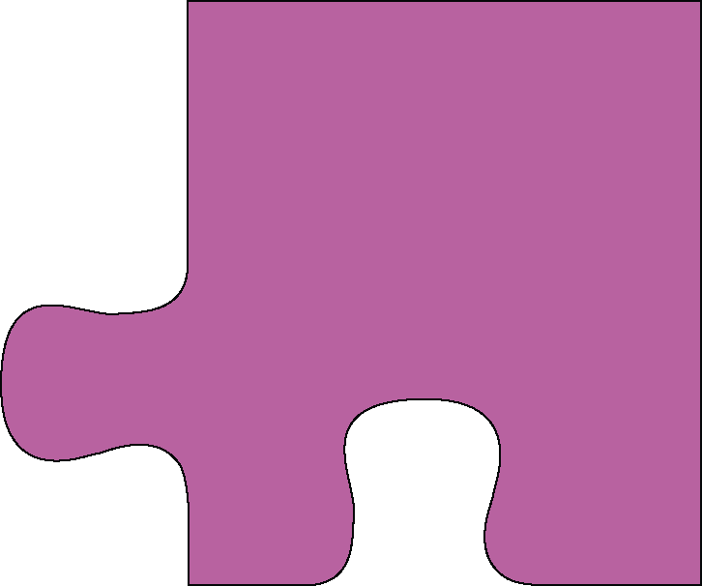
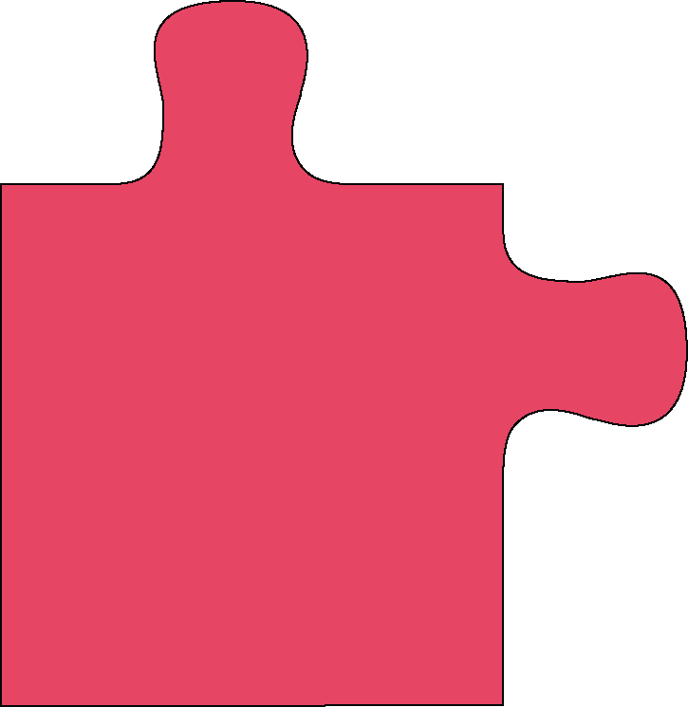
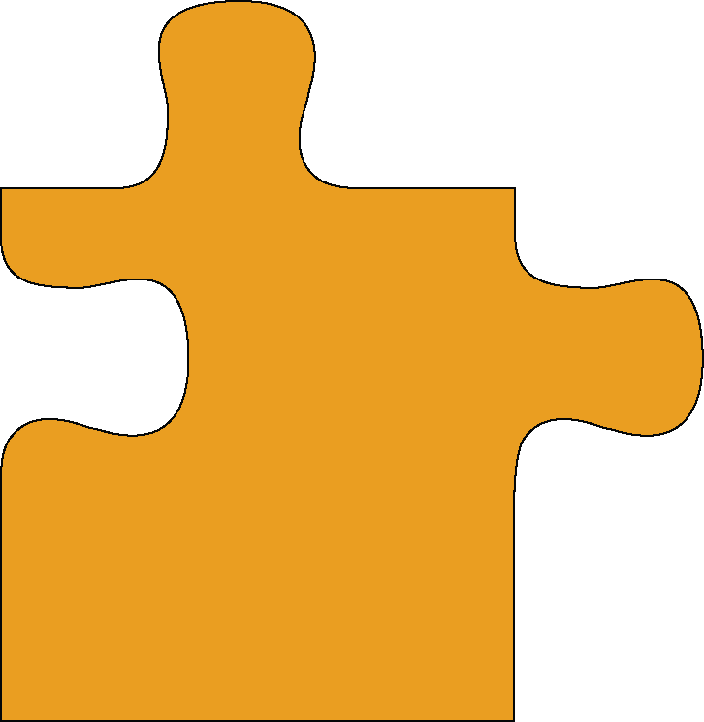
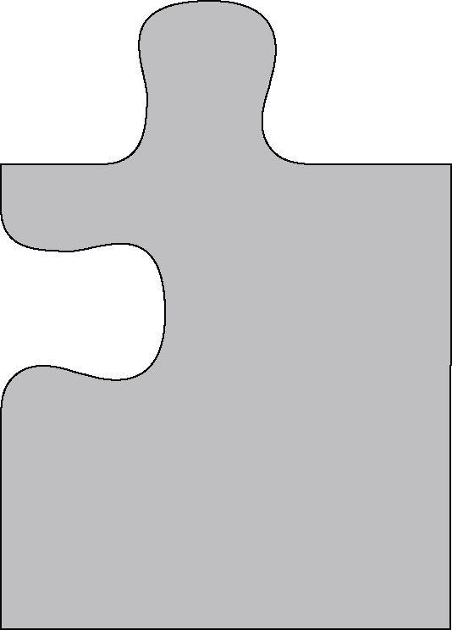
Research Thrusts and Capabilities of PPI Center
Shipping & Logistics
Smart Home
Smart Manufacturing
Smart Office
Precision Ag
Smart Health & Fitness
Smart Food
Smart Retail
Smart City
Runtime Safety for Autonomous Systems
Code Rennovation
Security
& Privacy
Explainable AI: Debugging NLP and Computer Vision
Program-
mabilty
Human
Factors
Energy-aware AI
Eco-driving and Routing for EV
AR applications on Edge
Smart Energy Transport-ation
Data
Science
Edge
Computing
Anomaly Detection
Fraud Detection
Open set detection
Data Cleaning/Sanitization
Notes:
We at the U of Colorado, OSU and U Michigan have a broad range of expertise in the underlying science, but our mission is not to build and commercialized these Personalized Intelligent Applications in the IoT verticals, this is what you, our industrial partners will do at your companies. Our mission is to come alongside you in industry, as the R&D partner, and help you build a platform on top of which you can build the vertical smart applications.
Lets look at the foundation platform that is needed to build such compelling PPI Applications of the future.
CLICK> There is no doubt that the killer applications for Intelligent IoT are software systems that heavily rely on ML and AI. For example, we work on projects such as Anomaly Detection applied to Fraud Detection, Reputation Management
But this is just one piece of the puzzle.
CLICK> The challenge is how do you deploy these on the edge of the network, where you have less computing power than on the cloud. How do you deploy this in the field where you have intermittent network connectivity and limited broadband bandwidth, and still need to make real-time decision? For example Trimble, one of our founding industry members has smart equipment that needs to operate in deep underground mines. Or for you at eBay, how to deploy powerful AI solutions on Mobile Devices that have limited capabilities?
CLICK> How do we build such software systems that do predictive analytics yet they respect the privacy and security and confidentiality of the data? This is super critical for a company like eBay that manages financial transactions for millions of customers.
CLICK> how do we make the battery-powered IoT devices and the AI software that runs on them more energy-aware, for you at eBay how we make the mobile App and virtual assistant more energy-aware? {{in the context of Electric Vehicles}}?
CLICK> How do we program this software systems, and how do we maintain and evolve them, how we can create a thriving ecosystem of contributors? When I talk to companies like eBay that grew fast from a startup to a big system architecture, I hear the same story. How do we renovate and keep the code-base up to date and manage technical debt. How do we remove code bloat so that we improve performance and maintainability? How can we enable outside contributors to build extensions to the eBay platform?
CLICK> and how do we construct ML sw systems that are usable by everyday users that do not hold a PhD in Machine Learning and AI? We work on problems such as explainable AI for NLP systems so that users understand and gain trust in such systems.
The complexity of this Problem domain is that you need to be really good in all these pieces of the puzzle.
It’s not enough to be the world’s champion in one the pieces of the puzzle. You need to be a champion on all these pieces.
Building PPI ecosystem was a formidable challenge even before the pandemic, but the crisis makes everyone rethink their approach to solving this through partnerships.
At the PPI Center we have world-class expertise in these pieces of the puzzle, and we are dedicated to collaborate with industry to make all these foundational pieces come together.
To leverage access to highly skilled individuals, last Fall, we launched the PPI Center as a unique partnership between industry, academia and government funding agencies.
=====

Slide 23
Value that PPI Center brings to you, students in CSCI 7000-008
Connecting you with movers and shakers in IoT:
access to thinking partners from industry
broadens your perspective
Networking opportunities: internships, jobs
Practical impact for your projects:
- gives you a chance for significance, not only personal success
Notes:
As I mentioned, even today, just a couple of hours before the class I was on a panel with industry executives from IoT areas. I am happy to share the learnings with you.
I am inviting several of these industry executives to be in a dialogue with you in the class. Next week we are scheduled to talk with Ricky Sing, the VP for IoT at Software AG, which is one of the largest software companies in Europe, I think the largest software company in Germany.

Slide 24
Course Administration
Check webpage: https://danny.cs.colorado.edu/courses/csci7000-008_Sp22/
Work items due Thu (Jan 13):
- Familiarize with class webpage
sign up on Piazza (all communications through Piazza, no email after this week)
Read and write a critique for a research paper (see template on webpage)
Check prereqs: computing background (either practical experience or undergrad-level knowledge of SE, Systems, ML), please check with me after the class
Notes:
TODO: ASK: How many people have been on the webpage already?
Open the web browser and navigate through the pages, spend some time at the Syllabus
The prerequisites of this class
If you have not taken the equivalent of these classes, but have several years of professional software engineering experience, this will work well too, but come and talk with me at the end of the class.

Slide 25
CS 7000-008 is Different!!!
Research-based course:
- at times it would feel it is not ”organized”
- there are lots of choices, you need to select
- structure is fixed, but content is dynamic
Complete a research or industrial-novel project of your choice (teams of 2-3 students)
follow the steps of open-ended/risky research (proposal, fit in literature, evaluate empirically)
at the end of the term you would have produced a research paper that you can submit to conference
WHY: equips you to conduct novel R&D
Notes:
This class is different and I can guarantee that it will stretch each of you.
- At times it would feel that the course is not organized. But this is normal.
This is how graduate-level course that is truly breaking new ground in the hot research topics should feel like.
Unlike an undergrad course where all students do the same tasks that are predetermined ahead by the professor, in a grad research class there are lots of choices, and the professor will let you select what works for you.
There is a fixed structure (we all read papers, we work on research projects that have the same milestones) but the content is very dynamic
CLICK
When you form teams for projects, I do not know ahead of time what are the projects (unlike in an undergrad class where the project is pure engineering and is known to all ahead of time)
CLICK
You will follow the steps of a typical research project (which are open-ended, risk-taking projects)
CLICK
If you do high-quality research & publish your research, you are guaranteed an A in the class!!
CLICK
At times, you might feel a bit lost in the beginning as you have to discover on your own, this will equip you with the skills you need to do well in graduate school.

Slide 26
CS 7000-008 is Different!!!
Participate in class discussion and activities.
Read 1-2 research papers for every class meeting (11 pages each, double column => total of 500+ research pages)
- later on, you choose papers that match your project
- 1 book chapter /week (Put Your Dream to the Test)
Paper Critiques: for each class meeting, for each research paper, submit before class (by 5pm previous day)
- WHY: equips you with critical thinking
Research presentation: you prepare and deliver for the selected research papers
- WHY: equips you to communicate your ideas
Notes:
Unlike in a undergrad class, there will be lots of discussions in my class. You will not be able to hide or escape, or take a mental break. You will have to actively participate in each class.
CLICK
When we read research papers, we do not know ahead of time all papers (unlike in an undergrad class where the professor knows ahead of time all lectures). A research-oriented grad course is dynamic, we choose to read papers as they are related to research project and the papers help you make progress on the research project.
CLICK
Submit your critique the day before the class (this gives the presenter a chance to add new material to help you better understand)
CLICK

Slide 27
Projects Focus on IoT-related topics
For new grad student, project gives ideas for dissertation
For experienced PhD student, project advances your research
Technological shifts/opportunities for IoT:
- constraints on memory/CPU/bandwidth/battery usage
- connectivity with the cloud
- rapid evolution of the platform
- reliance on ML/AI solutions
Industrial-innovation: availability of rich data from sensors (e.g., dataset from City of Denver)
Research projects (not an app), teams of 2-3 people

Slide 28
Example Transformations for IoT
What are the new transformations we need to automate?
- inspiration from explorative studies
- empirical studies to find performance or energy anti-patterns
Examples of transformations:
- candidate programs with trade-offs between performance & power consumption
- adaptation to different display technologies
- split functionality between the device and cloud
Notes:
TODO: put some thrusts from the CAREER

Slide 29
CS 7000-008 is Different! Lots of Guests
Interviews with C-level executives from PPI Center:
e.g., Jason Shepherd, CTO of Dell Technologies
Ricky Singh, VP of IoT at Software AG
Bob Wold, VP of Trimble
Rahul Khanna (Lead ML architect Intel IoT Group)
Watch segments from lead industry events (e.g., IoT World)
Broadcast of keynote speakers
Panel discussions
Faculty:
E.g., Tom Dietterich, father of the ML field, ACM Fellow
Notes:
I am not responsible for You, I am responsible to YOU. I will give you unprecedented access to people that you would never meet otherwise.
It’s up to you what you do with these resources and opportunities.

Slide 30
1-hour Group Discussion
Soft Skills: leadership, creating a
vision and plan for accomplishing
WHY: Soft Skills make a greater
Difference in life than “Hard Skills”
WHAT: Take your dream through
10-step process to see, own, reach it
HOW: learning environment in a
roundtable format
Notes:
Realize I will be disruptive: I need to be willing to communicate that I will be disruptive
I split the time between Hard Skills + Soft Skills. The way how I chose this 1 hour is very different from other classes.
I decided to use this 1 hour to focus on “Soft Skills”: on leadership, creating a vision. Soft Skills makes a greater difference than the hard skills. But the people who understand people skills use it to catch attention of others and lead others.
The book I selected for this as a resource: Put Your Dream to the Test.
Go back to when you were a child, dreams that you have. Encourage you to dream again, igniting within you the passion to envision dreams and aspirations.
This book will help you take your dream from thin air to achievable and it will help you to start accomplishing your dream.
We will answer 10 powerful questions that you can use as a step-by-step action plan to see, own, and reach your dream:
HOW: I believe the learning environment of the roundtable, the thoughts, ideas of others. Sharpen us. I myself am surrounding myself with a group of like minded faculty who are intentional in our growth and development.
I know we are off to a great start. I am looking forward to seeing you in class next Thu. If you have any questions and would like to talk with me, I will be happy to stay after the class for however long it takes to answer your questions.
Please register for the class, so that I have your contact information and I can send you the research paper to read for this Thu.
=====
position the change: why are we changing, and then relate the change. How the change will impact you, how life For you will get impacted after the change.

Slide 31
Bonus

Slide 32
Testimonials
“This course was exceptionally difficult and carried a massive time requirement. I only took two courses this quarter and even then I'm not sure I was able to give either of the classes the amount they deserved because of the time requirement for this class.” [student from previous years]
“… But that doesn't mean that I'm not satisfied, have students who previously took the course convey this”
Announcements for next class:
Read the webpage (after Tue), signup on Piazza
Office hours: right after the class
Notes:
This class will stretch you. I just want to warn you that this class is not for the easy at heart. This is what students who took the class last year said.
CLICK read
DO: turn to the neighbor on your left and right and tell them: this class will stretch you.
CLICK read
DO: turn to the neighbor and tell them: this class is tough but that’s right, it’s just what you need now.
CLICK The work for next class: read 2 papers and write critiques
- I mentioned that 562 has a prereq 561 which is usually offered in the Fall term, but was not offered last Fall. 561 itself has as prereq 361 and 362 undergrad SE classes. To check these prerequisites that you have the background knowledge to make you successful in 563.
- We will do an in-class 2-hour quiz, similar with the exams we give in CS361/CS362. If you have taken undergrad classes in SE or you worked in the SE industry, there is not much you need to prepare for this, though you might want brush up your knowledge by looking at what we cover in our CS361 and CS362.
CLICK
Office hours right after the class, I am willing to stay and answer your questions as long as it takes.
If you are not sure whether this class is right for you, come and talk with me.
MANDATORY: the students coming from the Pathway program must stay and talk with me at the end.

Slide 33
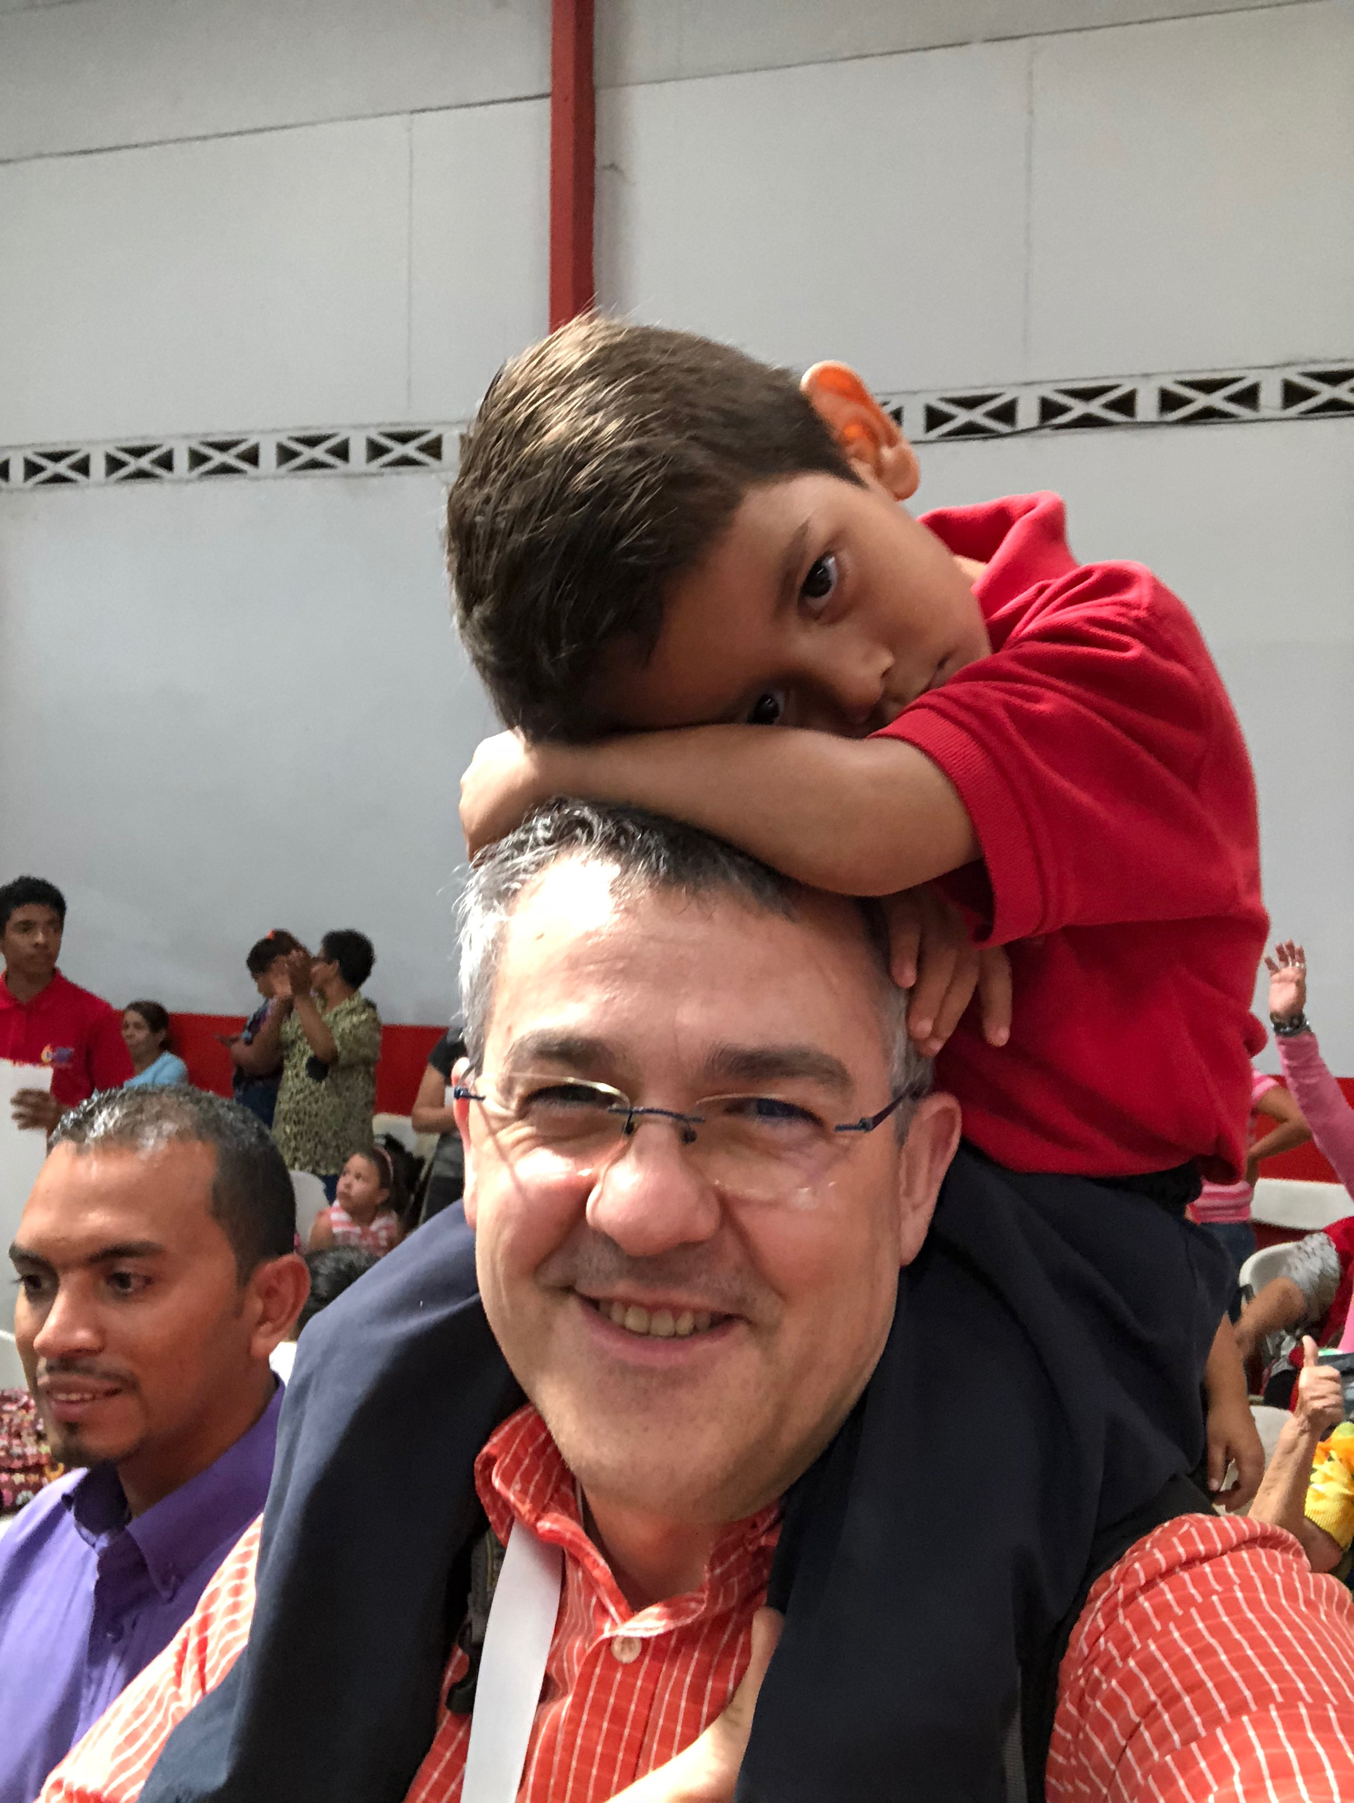
Motivation
Notes:
ASK: anybody knows what country soccer team wears this T-shirt (show them my CR t-shirt)?
Before the pandemic, I was invited by the president of Costa Rica and spent 3 weeks in CR with a team of 250 John Maxwell Leadership coaches training people of influence in your country how to raise the leadership level and to influence country, their organizations, their families.
We trained leaders in all the major streams of influence: in government and city legislators, in business, in education, in health-care, in social services.
But as I came to lead transformation for the nation, Costa Rica transformed me as well. In one of the days, we did social service at a special place that works with children coming from very difficult social backgrounds, whose parents are involved with drugs/alcoholism, and/or are in jail. These kids have been dealt a very poor start in life, but they are teaching me something else.
Meet Santiago, the boy on my shoulders. The kids were calling him Santi. As Santi latched on me, I could tell that he was deprived of love at home. Somebody in our group gave Santi one granola bar. Spontaneously and without any encouragement from others, Santi shared his bar with his siblings at the day care. I was very surprised about his gesture. My children in the US have plenty of everything, including several sweets every day. They are good children, but they do not share spontaneously, unless we encourage them to do so. And here it was Santi, sharing joyfully the only sweet bar that he probably received that week. I learned from Santi that we are happier when we give than when we receive. Are you a river or a reservoir? Do you let flow through you what you receive unto others? I want to be a river, not a reservoir. I want to pass onto others in my team what I am learning and growing into. This Sunday I am flying to the top leadership conference in the world, and I get to learn from the #1 leadership guru in the world, John Maxwell, the #1 NYT Best-selling author on leadership who who wrote more on the topic than the next 5 top experts combined. I am looking forward to sharing with you live from the conference what I am learning, so you can grow as well.

Slide 34
Reflections and Lessons
Notes:
ASK: how are we doing with time? How much time do I still have left?
When they say 20 minutes, make a joke and say the TA just gave me another 40 minutes to talk.
I am coming now to the second part of my talk, on reflections and lessons that I learned during my career on refactoring. I wish that somebody told me these when I started.
In this part you will have unprecedented access to
behind-the-curtain information on how I do research; I have never shared this before with students.
I am So excited to add lots of value to you.

Slide 35
L1: Work in Your Strength Zone, but Reinvent Yourself
Mobile
-add async
-fix async
-privacy
Parallelism & Concurrency
Refactoring
- make thread-safe
- improve throughput
- improve scalability
Library migration
- upgrade APIs
programs
Principles for changing between different programming models
Notes:
GESTURE: stand in the middle and point to part of the screen that I talk about.
Many times, people might tell you that you need to be good at everything: The truth is that you do not need to be an expert on everything, you need to know a little about everything (so that you can see conections) but focus on the area that you are excited about. Spend most of your time and energy in that area, do not attempt to be good at everything, because then you will not be good at anything.
This is my personal story of working on refactoring.
<CLICK> During my 5 years of PhD I worked on Upgrading library-based applications to use the latest API of their libraries, even when these APIs were refactored. In this stage I learned about static program analysis and learned the Eclipse refactoring engine so well that I became a contributor to Eclipse.
<CLICK> Just as I was finishing my PhD in 2007, the world of computing was completely shaken up when Intel stopped producing single processor systems, and went into multicore.
So my interest shifted towards refactoring existing sequential programs to make them run in parallel, make programs thread-safe, and refactorings to improve the scalability of already parallel programs
This new world forced me into much deeper program analysis than I have done before.
<CLICK> But just about when I started to get comfortable with parallelism, the world changed again. People stopped buying laptops and everyone was on mobile devices. So I took what I learned from the parallelism domain, and adapted it to the new challenges of working with event—driven apps.
Key lesson that I learned: many times I ventured beyond refactoring into other areas (like HCI or Compilers) that were weakness for me. I kept failing over and over until I learned to partner with others who were strong in the areas I was weak.
CLICK
I decided to stay and work in my strength zone: principles for refactoring programs between significantly different programming models, both in terms of the control-flow (from synchronous to callback-based, from sequential to parallel) and program state (from stateful to stateless execution, and from shared- to distributed- memory style of communication)
But at the same time I keep an eye open on big changes in the field of computing, and I am reinventing myself every 5 years. This way I remain fresh and keep learning while I stay in my strength zone

Slide 36
L2: Find Your Dream and then Live It
Automating
Inferring
- used at
- dozen labs
-ship with official
Refactoring
- hundreds of
accepted patches
founded Workshop
on Refactoring Tools,
HotSwUp, Dagstuhl S.
- first open-source
refactoring
Understanding
- shaped APIs in Java and .NET official concurency libraries
-learnparallelism.net 150,000+ visitors
Testing
Notes:
Identify your Dream.
What do you want. What do you really, really want?
Do you want to publish papers? Do you want to have lots of citations?
My dream for me is making a practical difference in the life of real software developers.
CLICK
For example, several of our refactoring tools ship with the official release of IDEs such as Microsoft Visual Studio (CORRECTOR, the tool which fixes async errors), NetBeans, and, Eclipse.
CLICK
Using our tools, we generated hundreds of change patches that were accepted in famous open source projects such as Apache foundation
CLICK
Several years ago I developed the world’s first open-source refactoring engine for Java
CLICK
The work on inferring API-level refactorings is used at Google, IBM, and dozens of labs
CLICK
Some of our testing work has been integrated in the testing infrastructure of the NETBEANS IDE at Oracle
CLICK
moreover, the formative studies that we conducted to reveal misuse, underuse, and abuse of parallel constructs has already shaped APIs in Java and .NET official concurrency libraries
Some of the educational resources that we developed, have already received hundreds of thousands of visitors
CLICK
I am not telling you all this to impress you, but to impress upon you that it takes a mindset and dedication to identify what’s your dream and to pursue it. None of these adoption in industry have happened by chance, by publishing papers and then hoping that one day somebody in industry finds them. I was proactively pursuing industrial collaborations.
You might think that sometimes publishing papers competes with your main purpose. I am learning how to make academic papers serve my main purpose by going the extra mile to move research into practice.
====
Stop here
Sometimes purpose and profits compete. Profits serve purpose – they don’t compete with it.
“We try never to forget that medicine is for people. It is not for profits. The profits follow and if we have remember that, they have never failed to appear” George Merk

Slide 37



L3: Be Proactive, but Be Flexible
Expected Company | Actual Company | Expected Target | Actual Target
Lambda
Expressions
Lambda
Expressions
Async
Programming
Security &
Privacy
Notes:
I value close interactions with industry. But these interactions don’t happen by chance, we have to intentionally look for industry partners.
Story1: In 2012, The Workshop on Refactoring Tools was held in Zurich Switzerland.
<CLICK> I arrived a day early and I went to IBM in Zurich and met with the developers for the Eclipse refactoring engine. I spoke with them about refactorings for the upcoming lambda expressions in Java 8. They told me that Eclipse compiler will not support lambda expressions for another year. I was disappointed but this did not stop me from looking for other partners. The next day at the refactoring workshop I met with the developers of the refactoring engine for <CLICK> NetBeans IDE from Oracle. They told me that the javac compiler infrastructure on which the NetBeans IDE was built, already supported the lambda expressions, so when I got home I hired two undergrads who worked on two <CLICK> refactorings targeting lambda expressions that we shipped with the official NetBeans IDE.
The lesson of the story: you have to be flexible and work with another company, learn other tools.
<CLICK> Story 2: I went to Google, to the Android Studio team to transfer the refactoring for asynchronous programming that I presented in the beginning of my talk. <CLICK> They liked this work, but they told me they are more excited about refactorings that improve security and privacy for Android apps. <CLICK> We started working together this year, and Google demo-ed a preliminary version of our refactoring at the Google I/O conference this year.
The lesson: Once you start working with an industrial partner, You need to be flexible with the scope of the work and be willing to learn a new technology.

Slide 38
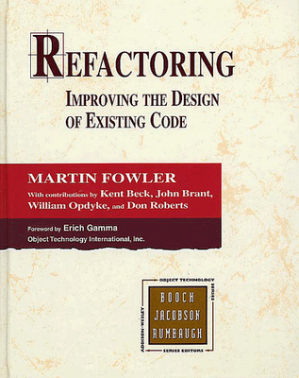
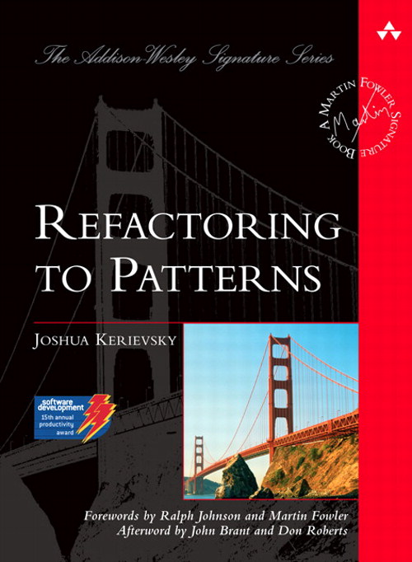
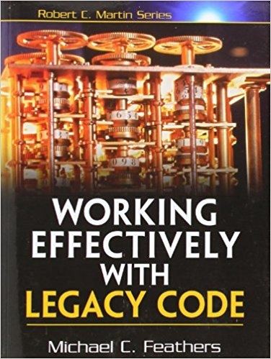
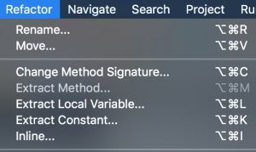
What is Refactoring?
“A change made to the internal structure of
software to make it easier to understand and
cheaper to modify without changing
its observable behaviour” – M. Fowler [1999]
Top-level menu in all modern IDEs
In 2000, I created the first
open-source refactoring tool
Notes:
ASK: how many people here have ever performed a refactoring?
I fell in Love with refactoring when I first read Martin’s fowler classic refactoring catalog in 2000, and I have been working on refactoring ever since.
Martin Fowler’s definition in the refactoring catalog.
ASKagain: with this defition of refactoring, how many people have ever renamed a function, or broke down a large complex function into smaller, simpler functions? How many people here have ever performed a refactoring?
A couple of other books that are big titles in industry and have influenced my path: Refactoring to Patterns and How to Work Effectively with Legacy Code.
Refactoring is today a top-level menu in all modern IDEs. I was fortunate to write the world’s first open-source refactoring tool for Java back in 2000, and I released it as a plugin for Jedit. For one year I was competing head-to-head with IntellijIDEA commercial refactoring tool, but then they beat me as they were a company with a full team of people. I learned an important lesson: you need a team of people if you want to accomplish something of significance.
So I no longer ventured solo, but I joined the Eclipse refactoring team in 2004, when I started contributing to Eclipse IDE.

Slide 39
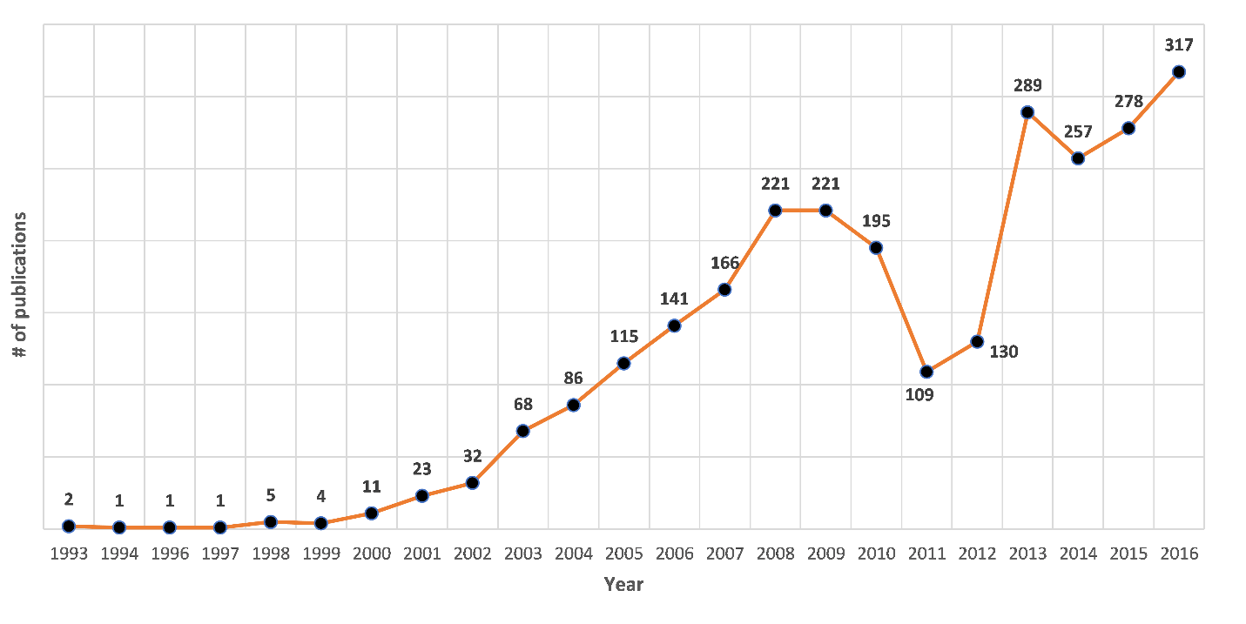
Refactoring research growth
2,880 refactoring papers (4,944 authors) since 1990
Notes:
On the academic side, refactoring research has also seen a tremendous growth, as seen in This graph. On the horizontal axis we have the timeline from 1993-2016, and the vertical we have the number of peer-reviewed published papers in each year.
Refactoring research started a decade before we saw the huge success and adoption in industry.

Slide 40
The Humble Beginnings
First refactoring paper:
- Bill Opdyke and Ralph Johnson [SOPPA’90]: Refactoring, an
Aid in designing application frameworks and evolving OO systems
PhD dissertations:
Bill Griswold ‘91 at U of Washington
Bill Opdyke ‘92 at U of Illinois
Don Roberts ‘99 at U of Illinois
Refactoring research hard to publish in early 90s
- conflated with the compiler community
Notes:
This is where I talk about the champions or the pioneers of the field.
First published paper: in 1990: at University of Illinois: By Opdyke and Ralph Johnson (my former PhD advisor, who most people would remember as one the 4 authors of Design Patterns). First paper using refactoring to create abstractions from existing applications and create frameworks from applications.
The birthplace of refactoring: was invented concurrently and independently at two universities:
- Bill Griswold and David Notkin at UW were looking at restructuring functional programs in Scheme. David Notkin was later on the PhD advisor of Miryung, so by academic genealogy, Bill Griswold is Miryung’s academic Big Brother.
Bill Opdyke and Ralph Johnson at Illlinois were studying the restructing of OO programs particularly in the frameworks context
Don Roberts PhD dissertation was the first one to present an industrial-strength refactoring tool for Smalltalk, he worked with Jon Brant who as an amazing tool builder. which heavily influenced Martin Fowler and Kent Beck, and all the refactoring tools that followed up.
At that time I was looking at what is the most active place of research in refactoring, so I joined Ralph Johnson’s research group in 2002 for my PhD work on refactoring.
I asked every single one of these pioneers what it looked like to research in refactoring in the early 90s and they all told me how hard was to publish as the research community looked at refactoring and said that it looks like compiler transformations, but they did not have the guarantees, the rigor and the formalism that the compiler community was used to.

Slide 41
Most recent Decade of Refactoring Research
2,880 refactoring papers since 1990
2,442 papers between 2005-2016
T. Mens
Notes:
After the appearance of Martin’s Fowler Refactoring classic, a lot more academics started to pay attention to refactoring, and I was one of them.
But the period I want to focus in my talk is the most recent decade from 2005 until 2016.
Why look at this period?
Survey by Tom Mens on the work until 2004.
More than 80% of all refactoring papers were published in the last decade
This decade is interesting because we see rapid rise, then some decline in the middle, and then an even more rapid growth
ACT: So we are going to do a tour-de-force on these 2400 papers. Please turn to your neighbor and tell them: fasten your seatbelt.

Slide 42
Corpus of Papers
Work done by Marouane Kessentini and his team at Michigan
Scopus and Web of Science
- "Refactoring” in title, abstract, and keywords
- yielded 3277 papers
Refactoring definition:
- transformation with behavior preservation
Manual validation of ALL papers:
- each paper analyzed title, abstract (and sometimes content)
- 4 grad students who took a graduate class on Softw QA,
- Kessentini (faculty) looked at the contentious papers
In the end we removed 397 papers
Notes:
Work done by Marouane Kessentini and his team at U of Michigan. I was simply an advisor and consultant to the project, asking them questions, but they are the ones who did all the digging.
We Searched for the term "Refactoring” in title, abstract, and keywords
- yielded 3277 papers
Refactoring definition:
- transformation with behavior preservation
Manual validation of ALL papers:
- for each paper we read the title, abstract (and sometimes content)
by 4 grad students who took a graduate class on
Software Quality Assurance,
and they voted if at least one said No, Marouane looked at the
paper himself
in the end we removed 397 papers

Slide 43
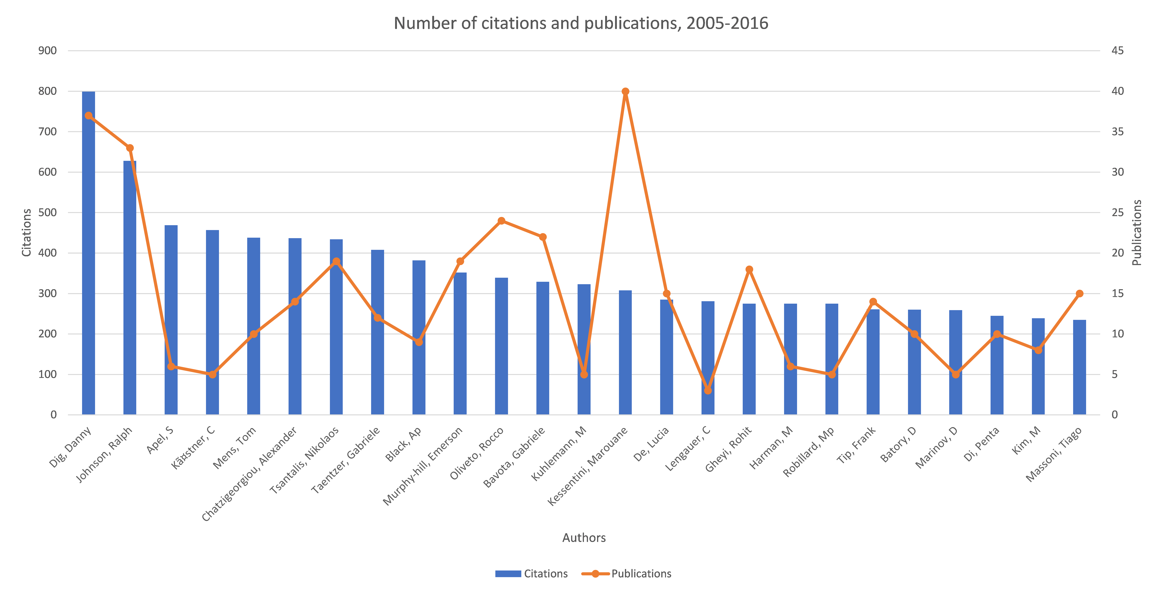
O1: To Grow, Welcome Outsiders, Champions from Other Communities
800 citations
37 pubs
Danny Dig
Apel, S.
Langauer, C
Batory, D
Kim. M
Ralph Johnson
Kastner, C.
Kuhlemann, M
Notes:
We first studied WHO is publishing actively in the last decade. This graph we look at the influence that prolific authors have on the community, based on the citations to their refactoring papers.
The blue bars show the total number of citations for refactoring papers, the orange line shows the total number of refactoring papers they published in the last decade..
CLICK: So on the left you can see authors like myself and Ralph Johnson that have both high number of citations and high number of papers, and are fairly established, the pillars of the community.
CLICK Your own professor, Miryung, is one of the top 25 most prolific people in the refactoring community.
CLICK Of particular interest to this community are some of the authors that you might recognize as active in GPCE: Sven Apel, Kastner, Don Batory, Lengauer, Kuhleman. They work a lot on refactoring for Software product lines.
So if you are looking to collaborate with somebody from your community who understands well both your field and refactoring, these are the people I would approach.
The first observation: if you want your community to grow, be welcoming to champions and outsiders who are crossing from other communities.
The corollary: if you are champion from a community A into community B, you can be very influential and cited, despite not publishing a lot of papers in the new community
Even more specifically for you, as PhD students, when you form your PhD committee, be intentional in inviting people from outside your area, as they can provide fresh perspectives and insights and can make your research more impactful.

Slide 44
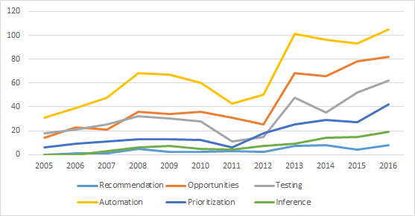
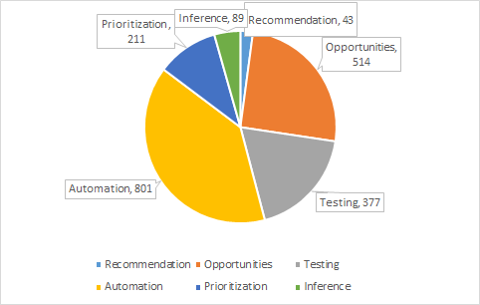
O2: To Grow, Expand Focus of Interest (the WHAT)
automating
insight
testing
prioritization
inference
recommendation
Expand focus to meet new needs that you can serve
Notes:
On the X axis we have the timeline, on the vertical we have different lines each represents a focus of research,
The original focus was on automating the changes carried by refactorings.
Most of the research done today is still on Automating of the changes
Second is the Refactoring Opportunities -- gain Insight where in the code we need to introduce refactoring),
In the beginning the community thought that the Insight comes from domain knowledge of the programmer, but now the community is working on generating Insight.
WHY: More developers are working on code that was written by other developers who left the company, they need to gain insight about which parts of the code need refactoring.
Testing: the correctness of the code changes applied by the refactoring tool. ICST'16 had 4 papers on testing the correctness of refactoring tools. This makes sense about increasing the Trust of the refactoring tool (this is one of the most costs/barriers for people adopting these refactoring tools in practice, especially when people consider refactoring as an overhead cost of ensuring the correctness of the changes).
Prioritization: scheduling of refactoring opportunities. When programmers received hundred of recommendations, prioritization is becoming important as programmers cannot apply all the hundreds of recommendation. The growth spur is correlated with the growth of Technical Debt community (first workshop appeared in 2001)
Inference: Your own Professor, Miryung Kim is a leader in the field of refactoring inference: tools for automatic detection of refactoring activities that already took place in the code. This is important for understanding the evolution of code, program comprehension, and many more applications.
CLICK> To Grow, Expand the Focus (WHAT) of Interest, become broader, think about the needs of the people you are serving and how you can meet those needs.
===
Recommendation part: what sequence of refactorings to apply to solve the problem. it does not apply automation support to apply the refactoring automatically.

Slide 45
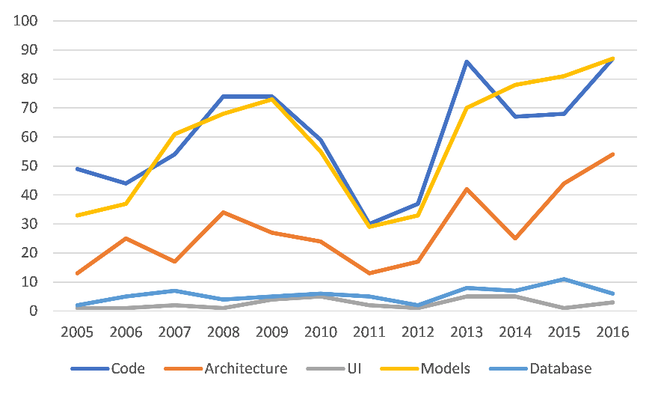
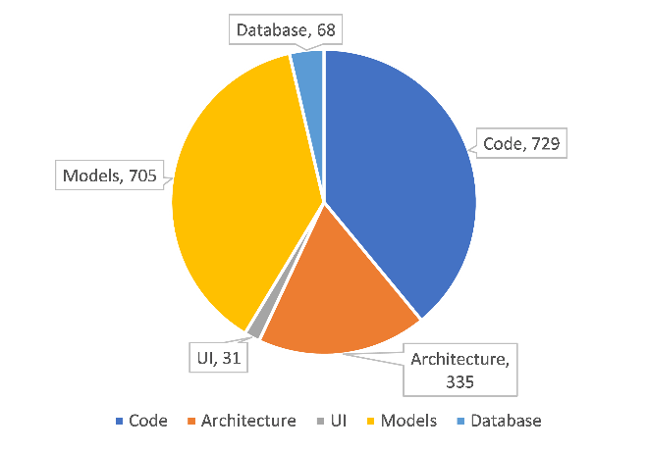
O3: To Grow, Expand the Target Artefacts
models
code
architecture
DB
UI
Expand target: new refactoring research is about change to the code, models, architecture, DB, UI
Notes:
Surprising: refactoring for models has surpassed refactoring code. This is good news for this community.
Lots of room to grow in other areas. Fro example, in this class you are studying big data, so a fertile direction could be Refactoring DATA

Slide 46
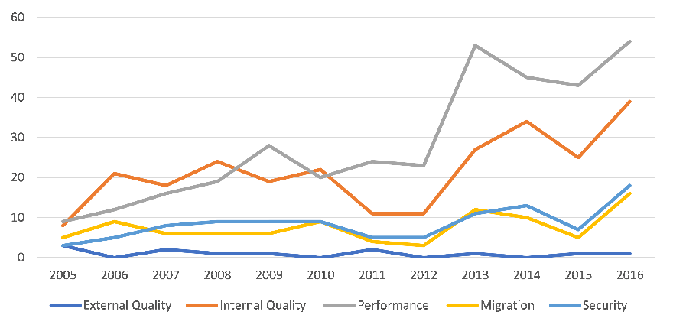
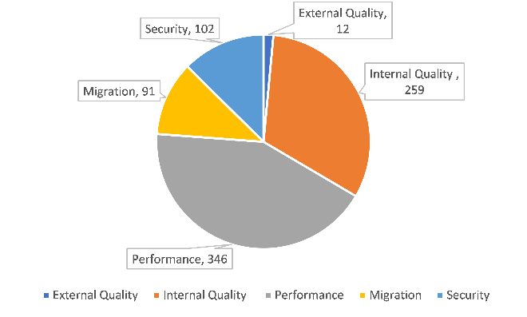
O4: To Grow, Expand Objectives (the WHY)
performance
internal quality
security
migration
Expand Objectives: new refactoring research is to improve
performance, security, migration (beyond internal quality)
Notes:
The original motivation was to improve code quality, but we have seen huge growth in other objectives
Very surprising: starting with 2010, performance was the main target, even more than Internal quality. Many people in the industry mention as the main goal for refactoring to be performance. the research community realized that the performance is more marketable: you can say that you make a change that might improve the maintainability of your software in a few years, but how do you measure this? In contrast, performance is quantifiable, has an immediate impact that end-users can sense.
Migration: transformation between programming languages (COBOL to Java, C to C++,) or migrating between libraries
CALL to ACTION: The surprising part is security: we would like to see more work on Security preservation when I integrate modules (in autonomous vehicles).
Can we still preserve the security constrains (not only the behavior)?

Slide 47
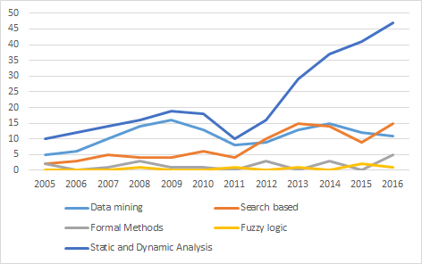
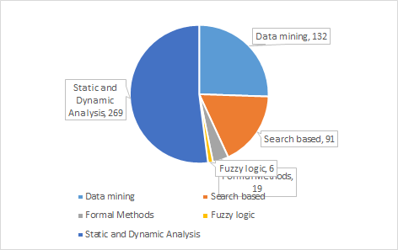
O5: To Grow, Adopt new Techniques (the HOW)
static & dynamic
analysis
search-based
data mining
New refactoring research via static analysis, search-based,
data mining
Notes:
We see that the bread-and-butter is still static analysis: people using compiler representation (AST, binding information and control-flow), more sophisticated analyses include heap-based abstractions such as points-to analysis
The increase of search techniques is scalability (paper that use methods like GA, simulate anealing) the growth was caused by the growth of the optimization field with multi-objective search
Data mining – this is a place where students in this class you are well positioned to make significant contributions. for people who want on technical debts, prediction of refactoring, they are trying to mine existing data to infer outcomes.
The availability of the data, lots of tools now that record the changes made in the code
The spike comes from the growth of the MSR community
====

Slide 48
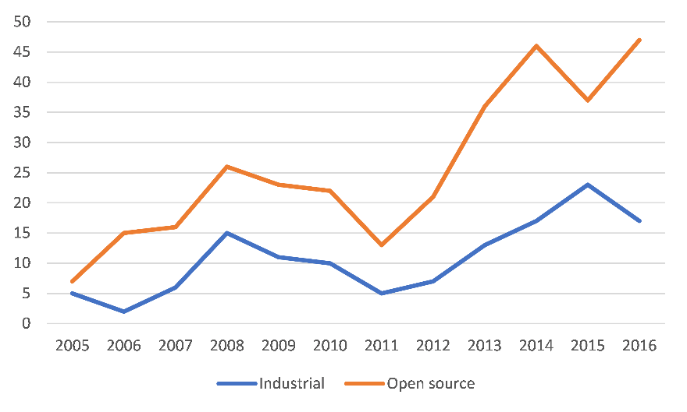
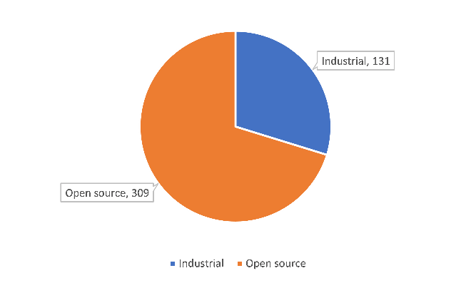
O6: To Increase Practical Impact, Work with Industry
Open-source data
industrial data
Industrial collaboration levels:
- surveys with practitioners
- tool validated on industrial codebase
- tool licensed to industry, adopted in products
Notes:
How do we know that our research works? The vast majority in the refactoring community employ empirical evaluation (as opposed to analytic evaluation with proofs of correctness)
These papers used open-source data: evaluation means applying the tool on some project, or replicating refactorings scenarios that open-source developers applied.
I am very excited to see an increase in the number of refactoring papers that involve industrial collaboration
This is much harder to do as to bring business value to the company the researcher must go the extra mile and work harder.
But this is the one that has the greatest potential for changing the world of software development.
Collaborators from industry tried the tool, gave feedback, the code is used by the industrial partner with sub licensing.
I am very excited to mention as an excellent exemplar the work of Miryung Kim, your own professor to study the practice of Refactoring at Microsoft.
Call for Action: more industrial validation.

Slide 49
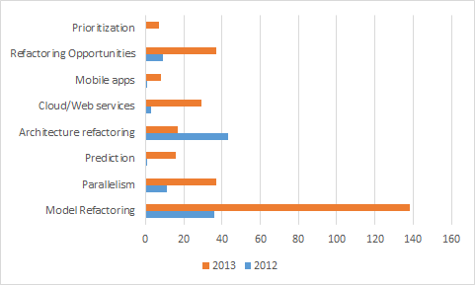
The Big Growth from 2012-2013
Notes:
Lets look now at the big growth spur that happened from 2012-2013> Switch to Slide #5
When done, switch back to slide 13

Slide 50
Big Growth of the Field: Expanding Definition
“Automation/insight/testing/prioritization of changes to the artifacts of software to improve non-functional requirements and without changing its proper, intended behaviour” – D. Dig ‘17
“A change made to the internal structure of software to make it easier to understand and cheaper to modify without changing its observable behaviour” – M. Fowler ‘99
Expanded Focus, Objectives,
Techniques
Communities that thrive are going to be more accepting of
new ideas
Notes:
The significant expansion of the refactoring definition:
CLICK> We have seen a significant expansion in the focus of the community (moving beyond automating changes to insight, testing, prioritization), the Target expanded
Beyond code to include models, architecture, UI, DB, the objectives expanded beyond Internal Quality to Performance, Security, Migration, and the
Preservation of behavior has expanded to preserving the proper intended use of behavior, but changing the improper behavior (for example by eliminating security exploitable, hackable behavior)
CLICK> Communities that thrive are going to be more accepting to new ideas.

Slide 51
Big Growth Enabled by Community Engineering
Industrial champion(s): M. Fowler, Kent Beck, Ward Cunningham
Complementary skills: tool builders, paper writers, curators
Mindset for industrial collaboration and adoption
Shared platform:
- Eclipse (Erich Gamma + Frank Tip), analysis frameworks
Community infrastructure: 7 Refactoring Workshops, Dagstuhl
first workshop in 2007, 50+ participants, 32 posters
invited all major IDE providers
growing new leaders
Notes:
Here are other factors, mostly on the social part, or community engineering that contributed to the growth and impact of the field.
Attracting strong industrial champions: we have seen that the field of research has really taken off only after Martin Fowler’s publication of the Refactoring book, and the campaign of influential thought leaders in industry like Kent Beck and Ward Cunningham (the Inventors of Extreme Programming)
CLICK Most people in the academic community are great at publishing papers, and we need to partner with people that have complementary skills, great tool builders.
We have seen this over and over again in the famous big successes in our community (Don Roberts and Jon Brant, Eclipse team: Frank Tip form IBM Research and the Eclipse Java Development Tools team in IBM Zurich).
We created a nice ecosystem with researchers supporting the industry and vice-versa.
CLICK Proactively seek industry collaborations.
CLICK: having a shared platform that the community could build upon: We adopted Eclipse, it was open source (but developed like professional software of industrial strength quality, with yearly major releases, backed up by IBM). The documentation was not great, but Eclipse had great developer support forums, researchers could learn from reading the source code of other refactoring plugins,
- Program analysis infrastructures, like WALA and SOOT.
CLICK Community Infrastructure:
We had 7 refactoring workshops, Dagistuhl seminar. I organized the first 4 refactoring workshops. At the first refactoring workshop I organized in 2007 at ECOOP, we had 50 participants, 32 of them presented posters and we had a big display of 32 refactoring posters that year at ECOOP (about 2/3rd of all posters at ECOOP that year were on Refactoring), so on the hallways I heard other people talking how it seems that everyone at ECOOP is working on refactoring.
CLICK I also invited at all these refactoring workshops the people from industry who were building the refactoring infrastructure: at Eclipse, NetBeans, Intellij, Visual Studio. This was crucial for the research community to meet these industry people, learn about the undocumented features they needed to use, exchange tips and tricks
CLICK While I was the one in charge of the first 4 refactoring workshops, I realized I need to attract new leaders and make room for others to get involved in leadership, if this was going to take off and reach significant success
====
Time 2min:55sec

Slide 52
L4: The Killer Offer
Failure - The Backdoor to Success
Establish the value of the paper, than go the extra mile
Killer Feature #1: large-scale formative study for mapping the landscape where you plan to create a solution
Killer Feature #2: large-scale empirical evaluation (e.g., 2972 applied refactorings in LambdaFicator – FSE’13)
Killer Feature #3 : show you add value in the real world (e.g., ICST’13 developers accepted 60 of our patches)
Notes:
This last lesson is more relevant to academics who live in world ruled by “publish or perish”.
You need to embrace failure. I call it the backdoor to success, because failure will teach you more lessons than success will. My ISSTA’13 paper was rejected 4 times before it was accepted at ISSTA and won the award for that year. Every single time when the paper was rejected, we looked at the reviews and asked ourselves what can we learn. I never told myself: that the reviewers were lazy. I always said: what can I do different next time so that the paper won’t get rejected.
Through these reflections, I discovered a series of principles that I will happily share with you to increase the chance of getting your paper accepted.
CLICK When you write a research paper, think about yourself as a salesman who wants to sell a product (i.e., your research) to the buyer (the reviewer in a program committee).
First, you must establish that your paper has real value: good problem to solve, sound solution, convincing evaluation, polished presentation. If you have all this in a paper, then you have a solid paper that provides good value to the buyer: the reviewer won’t be ashamed to put his stamp of approval.
Then go the extra mile and ask: what is the killer offer that you can make as a seller, so that it will create remorse in the buyer if he does not buy it?
Killer Feature #1: a large formative study that maps the landscape of where your refactoring will apply. Remember how in the two papers I presented in the beginning of my talk I described what we learned about the Asynchronous landscape of Android and .NET.
Killer Feature #2: Boost up the size of your empirical evaluation one order of magnitude over what the reviewers expect.
Did we learn anything new after we applied a couple hundred refactorings? Absolutely no. But it convinced the reviewer beyond any shaddow of doubt that our refactoring works on real code.
Killer Feature #3: Using our static analysis in the ICST’13 paper we discovered several bugs in developer’s code. The developers confirmed 60 as new bugs and accepted our patch. This convinced the reviewer that what we are doing is important and needed in practice (because developers accepted our patches).
When you bundle up one of these Killer Features with your main offer (which you already established the main paper has good value on its own), you make your paper almost impossible to be rejected.
When you bundle up ALL 3 of these Killer features, you create the KILLER offer that results in an award paper.

